Slide 1
GARM: September 2022 Community Call
29 Sept 2022

Slide 2
GARM September Community Call Agenda
AGENDA ITEM | OVERVIEW | TIME ALLOCATION
Content Policy Working Group: At-risk users | YouTube to present on they are approaching at-risk users on their platform | 15m
Standards and Definitions: Misinformation Implementation Guide | Misinformation implementation guides + top-line analysis by GARM EC CoP Update | 20m
GARM Training Preview | Preview on content of GARM training and logistical details | 10m
Adjacency Working Group Update | Update on GARM’s adjacency work around live audio and video | 5m
Aggregated Measurement Report Vol 4 | Timeline Overview | 5m
AOB |  | 10m

Slide 3
WFA Competition Compliance Law
The purpose of the WFA is to represent the interests of advertisers and to act as a forum for legitimate contacts between members of the advertising industry. It is obviously the policy of the WFA that it will not be used by any company to further any anti-competitive or collusive conduct, or to engage in other activities that could violate any antitrust or competition law, regulation, rule or directives of any country or otherwise impair full and fair competition. The WFA carries out regular checks to make sure that this policy is being strictly adhered to.
As a condition of membership, members of the WFA acknowledge that their membership of the WFA is subject to the competition law rules and they agree to comply fully with those laws. Members agree that they will not use the WFA, directly or indirectly, (a) to reach or attempt to reach agreements or understandings with one or more of their competitors, (b) to obtain or attempt to obtain, or exchange or attempt to exchange, confidential or proprietary information regarding any other company other than in the context of a bona fide business or (c) to further any anti-competitive or collusive conduct, or to engage in other activities that could violate any antitrust or competition law, regulation, rule or directives of any country or otherwise impair full and fair competition.

Slide 4
Protecting At-Risk Users: YouTube Overview

Slide 6
Standards and Definitions: Misinformation Implementation Update

Slide 7
An overview of our work to date + context for today’s conversation
ALIGNMENT ON DEFINITIONS
Safety + Suitability Framework v1 [Sept 2020]
Safety + Suitability Framework v2 [June 2022]
TRANSPARENCY ON IMPLEMENTATION
Topical Implementation: Misinformation Implementation Guide
COLLABORATION ON APPLICATION
Expanded Guidance via IAB TechLab
Open-Source Proposal via GARM Solutions Developers Working Group

Slide 8
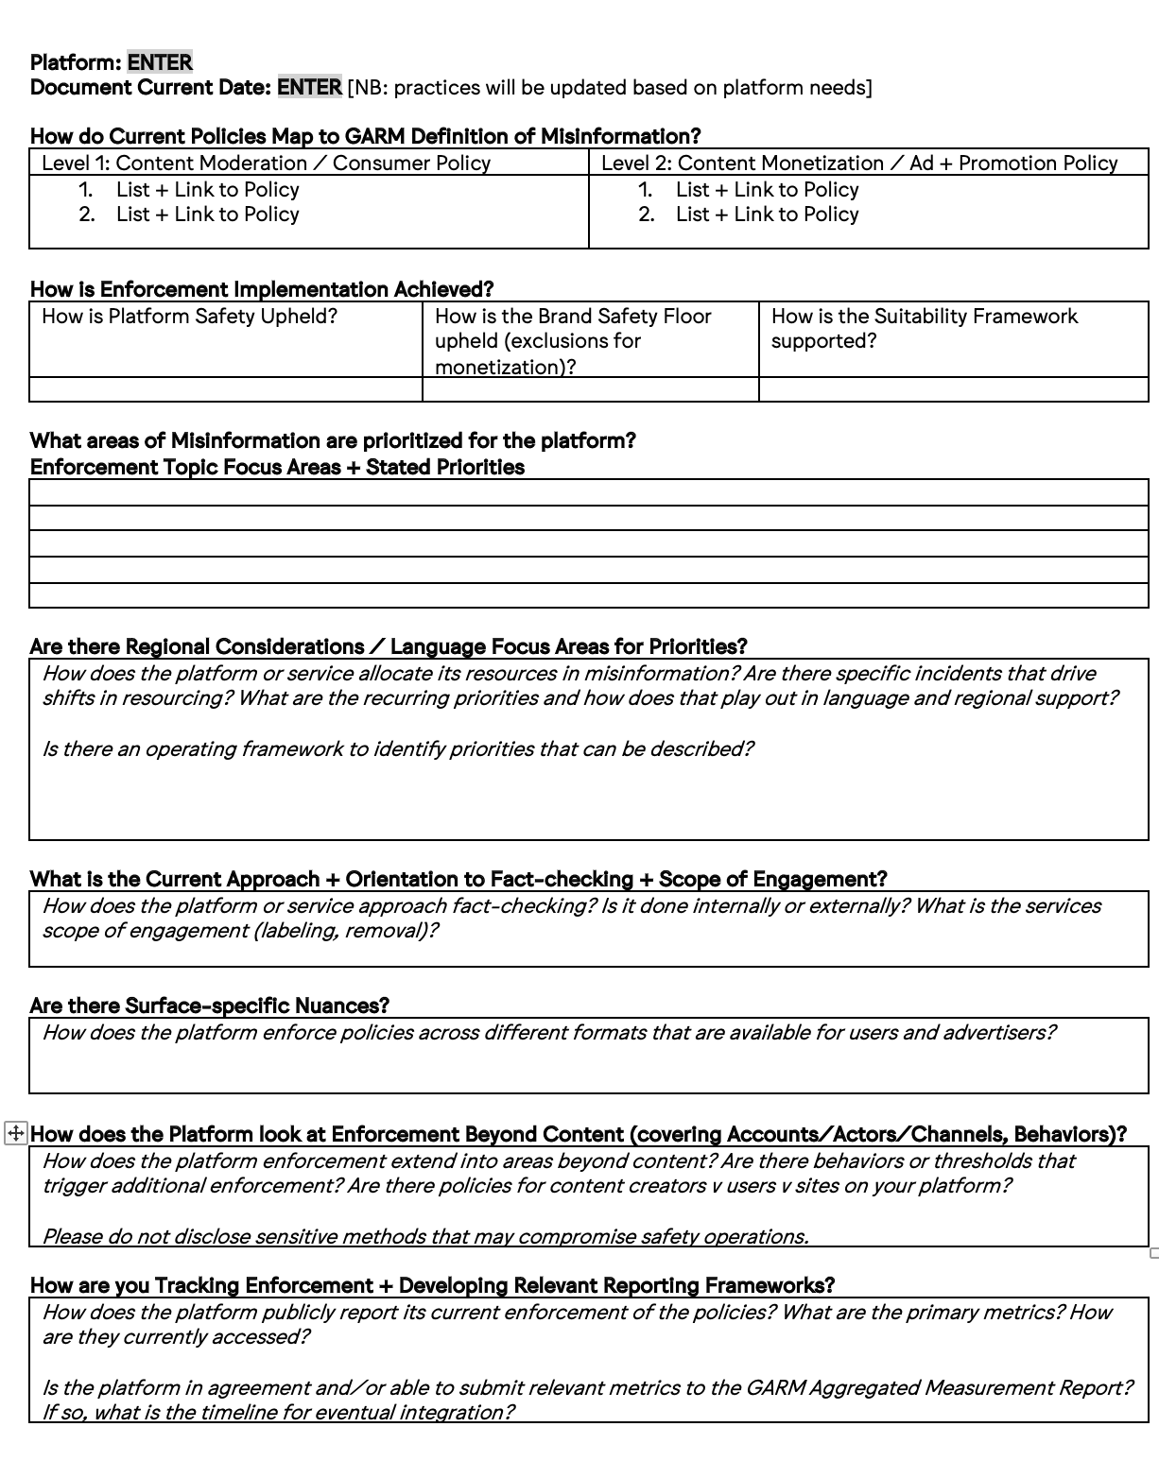
Misinformation Implementation Guide Overview
Improve transparency by establishing disclosure by ad sellers
Key areas for understanding:
Policy coverage
Topical focus
Application focus
Role of Fact-Checkers
Current Measurement Practice
Currently developing analogous process for ad-tech + solutions developers

Slide 9
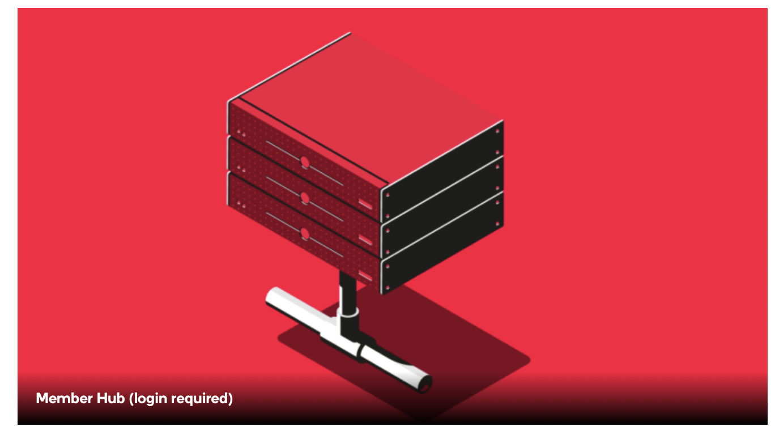
Misinformation Implementation Guide: Participation + Access
CURRENT PLATFORM SUBMISSIONS AVAILABLE
LOCATED IN GARM MEMBERS HUB
YouTube
Twitch
Meta
Spotify
Pinterest
Twitter
TikTok

Slide 10
Misinformation Implementation Guide Analysis: Policy Coverage
All platforms address Misinformation / Disinformation on organic user behavior via Content Policies
Most platforms extend that into paid manipulation via Ads Policies

Slide 11
Misinformation Implementation Guide Analysis: Policy Coverage
All platforms have had topical focus shaped by real world events, regulatory requests, and work with civil society groups
Pandemic + Medical, Elections, and Distortions have near universal prioritization
Climate Change and Public Emergencies don’t have universal focus at current
TOPIC | PLATFORMS STATED PRIORITIES
COVID + Health + Medical Misinfo | 7
Physical Harm + Dangerous Events | 7
Elections + Census | 6
Manipulated + Synthetic Media | 6
Climate Change | 3
Public Emergencies | 2

Slide 12
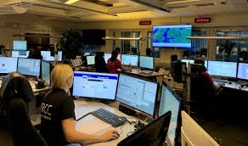
Misinformation Implementation Guide Analysis: Application Focus
All platforms indicate that policies are global
Nearly all platforms indicate there is a central team that directs application of regional and/or local resources
VLOPs disclose coverage in 60+ languages and/or markets

Slide 13
Misinformation Implementation Guide Analysis: Role of Fact-Checkers
4 of 7 platforms disclosed their fact-checking processes to GARM
The majority (3 of 4) have external-driven fact-checking services
The scope of fact-checkers is commonly described as:
Rating of content
Informing of machine learning
Review of machine learning
Supporting special incidents
Work of fact-checkers was also discussed in context with credible organizations

Slide 14
Misinformation Implementation Guide Analysis: Current Measurement Practice
5 of 7 platforms are currently reporting on efforts in first party transparency reporting efforts
Of those reporting the dominant metrics shared are:
Platform Enforcement: Removals of Content (5 platforms)
Platform Enforcement: Removals of Accounts (2 platforms)
Platform Enforcement: Views of Content Removed (2 platforms)

Slide 16
Misinformation: Overview of EC CoP Next Steps
Currently in workshops to identify Service Level Indicator for the Code of Practice [e.g., total impact of behaviors by signatories]
The desire is to develop a metric that shows financial and/or total of activities
Current conversations are focused on:
Protecting Spend (by ad buyers)
Preventing spend by bad actors (by ad sellers),
Reducing reach of harmful content (by media platforms)
Preventing ad yield by bad actors (by ad sellers)
Ultimately, signatories will develop a self-reporting template that will be folded into ongoing reporting and monitoring work

Slide 18
GARM Training: Mobilizing Users

Slide 19
Context for Education Efforts
GLOBAL STANDARDS + TOOL DEVELOPMENT
RAISE THE FLOOR: LOCAL MOBILIZATION
RAISE THE CEILING: KEY TOPICS

Slide 20
Education Structure: Masterclass and Bootcamp
RAISE THE CEILING Masterclass:
For digital media leaders, brand safety SMEs, trust & safety SMEs
RAISE THE FLOOR Bootcamp:
Media practitioners (advertiser, agency), Platform practitioners
In-person
In-person
Virtual
E-Learning

Slide 21
Education Structure: Masterclass and Bootcamp
RAISE THE CEILING Masterclass:
For digital media leaders, brand safety SMEs, trust & safety SMEs
RAISE THE FLOOR Bootcamp:
Media practitioners (advertiser, agency), Platform practitioners
REGULATION & SELF-REGULATION
METAVERSE
A NEW AGE FOR MEDIA LEADERSHIP
Brand Safety in Context
Strategy Setting + Alignment
Operationalizing via Planning, Reporting, Buying
Working with Partners – Platform + Tech
Crisis Management

Slide 22
Education Roll-out: Event 1 NYC
Masterclass: Wed Nov 2
Bootcamp: Thurs Nov 3
Reach out with interest:
Free tickets (limited amount)
Travel discounts (hotel room block)
Reach out to r.rakowitz@wfanet.org, d.goodwin@wfanet.org for information

Slide 24
Adjacency Standards Working Group Update: Next Steps

Slide 25
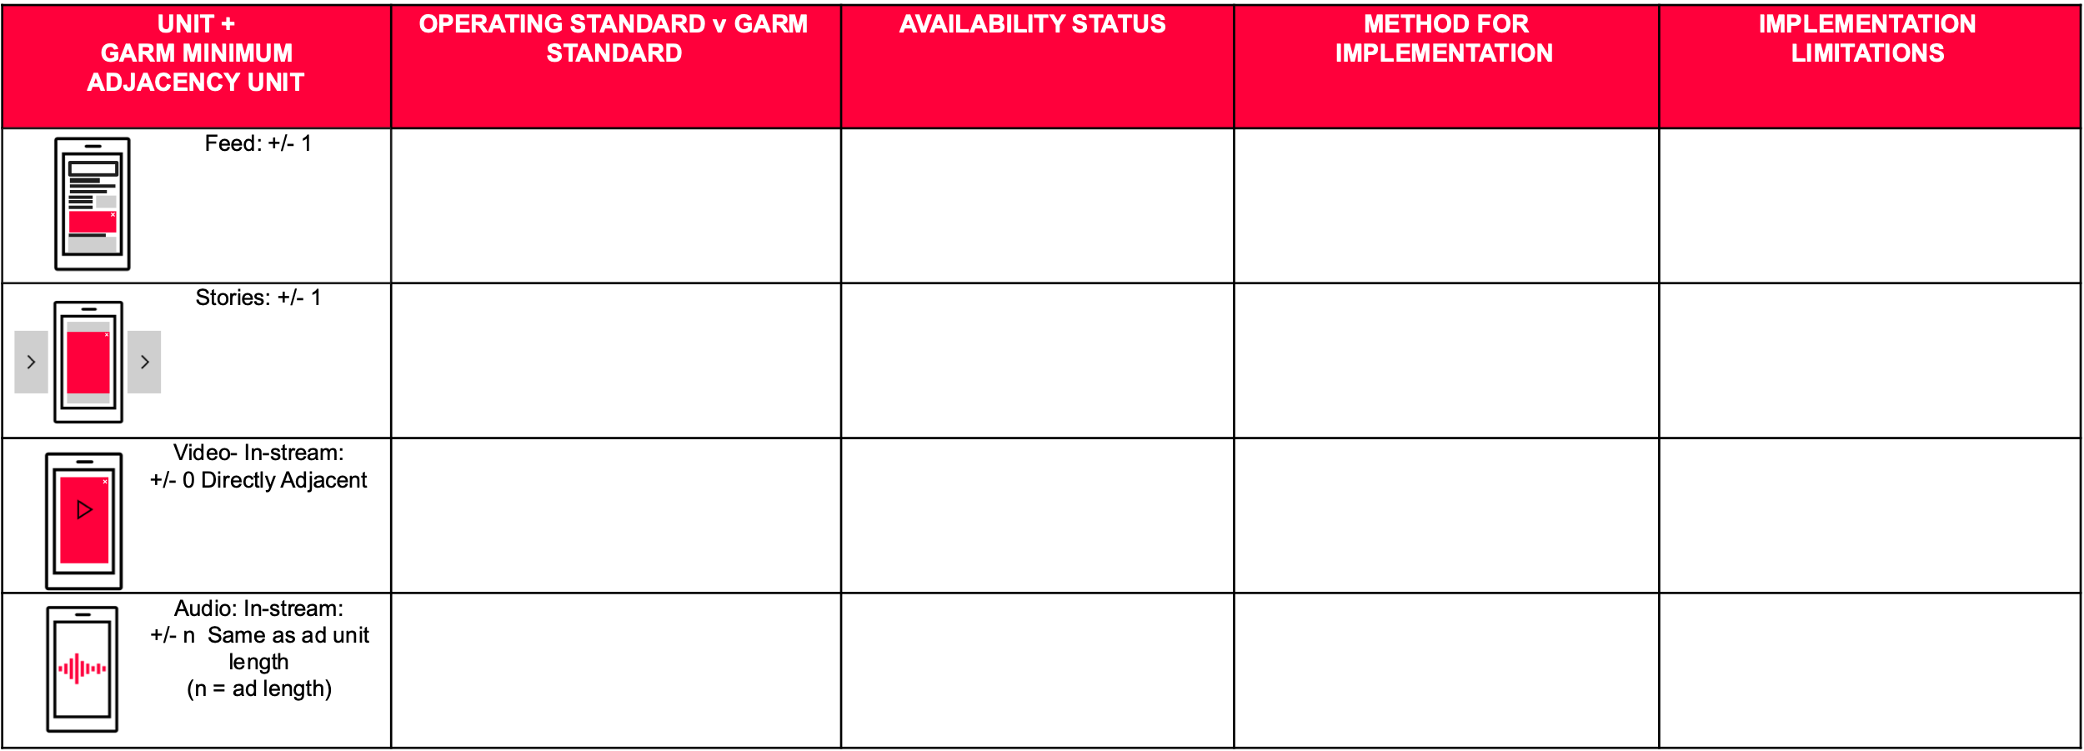
Adjacency Standards Working Group: What’s Next
Drive disclosure on current availability
Resolve needs on Livestream
Implementation overview to track availability + development
Overviews in October
Workshops underway to define practices + identify a standard
Goal by end of year

Slide 27
Measurement: Aggregated Measurement Report Vol 4

Slide 28
Aggregated Measurement Report:
A reminder + preview
COLLECTION [TO OCT 4]
Platform Data
Platform Insights
SYNTHESIS [TO OCT 20]
Macro data trends
Implications
ROLL-OUT [EARLY NOV]
Community Share-out
Public comms
The Aggregated Measurement Report is our consolidated report that allows the advertising industry to drive a practice-specific view on safety practices
At current, it is only focused on ad sellers (platforms)
We’ve defined 4 questions and 8 measures, and we’ve seen 67% of submissions adhere to GARM’s measurement best practices (e.g., Authorized Metrics)
The major new news thus far is that LinkedIn is joining Vol 4!
There will be special acknowledgement of the Russian Invasion of Ukraine, and also our work on Misinformation + next steps

