Slide 1
GARM Community Call April 2022
5 May 2022

Slide 2
Agenda

Slide 3
Compliance

Slide 4
Measurement + Oversight Aggregated Measurement Vol 3

Slide 5
Aggregated Measurement Report: The work in context
Common Measures is 1-of-4 key pillars for GARM
Common Measures is designed to track how we are collectively progressing on efforts to remove harmful content, with a focus on content monetization
The Aggregated Measurement Report creates that common framework, a shared point of access, and a set of measurement best practices
Now in Volume 3, the report as an effort is 1 year old
INDEPENDENT VERIFICATION
ENDORSEMENT
COMMON DEFINITIONS
MRC ACCREDITATION
COVERAGE
TAG CERTIFICATION
INTEGRATION
ENDORSEMENT
COVERAGE
PARTICIPATION
AUTHORIZED METRICS
INTEGRATION
COMMON CONTROLS
COMMON METRICS

Slide 6
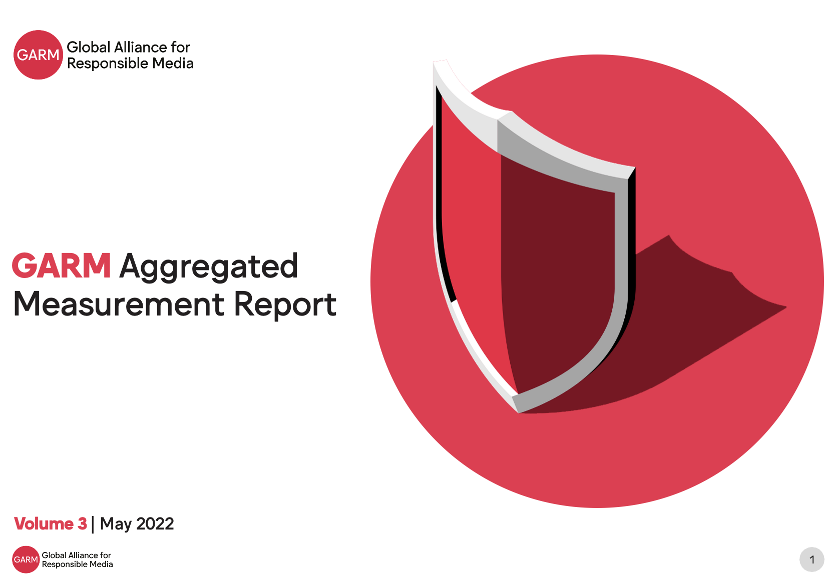
Aggregated Measurement Report: Driving change
More platforms participating and more to join
More granular levels of data provided at the category or policy level
Metrics specific to monetization safety are being shared for first time
Metrics set up for audit in the MRC Content Level Brand Safety Audit
Metrics being corroborated by other research

Slide 7
Aggregated Measurement Report: What we’ve learned so far
Data reflects individual platform efforts: Underlying data is reflective of platform-specific rules or policies. Further, the metrics are reflective of measurement breadth and enforcement actions
Complex and combined analysis is not appropriate: Due to the differences in policies, and some platforms counting harmful content differently (e.g., a single piece of content violating multiple policies or one) data presented by individual platforms or in the Aggregated Measurement Report cannot be tallied
Time-series trends can be assessed but with context: Trended data within a platform can be analyzed over time. However, this must be done in context as there are changes in enforcement, policy, and even the volume of content.
Value in looking at content categories and trends: The most valuable area to analyze is looking at trends across categories or looking at broader trends. This is where the Executive Summary commentary is most often sourced.
Increasing usefulness in driving focus and in strategy: Helpful to focus stakeholders in advertising onto core metrics with quality control, and increasingly helpful as an input on global media quality scoring

Slide 8
Volume 3: Data x Time coverage
 | Q3 2020 | Q4 202 | Q1 2021 | Q2 2021 | Q3 2021 | Q4 2021
 |  |  | PREVIOUS PERIOD | PP | LATEST PERIOD | LP
 |  |  | PREVIOUS PERIOD | PP | LATEST PERIOD | LP
 |  |  | PREVIOUS PERIOD | PP | LATEST PERIOD | LP
 | PREVIOUS PERIOD | PP | LATEST PERIOD | LP
 |  |  |  | PREVIOUS PERIOD | LATEST PERIOD | LATEST PERIOD
 |  |  | PREVIOUS PERIOD | PP | LATEST PERIOD | LP
 |  |  | PREVIOUS PERIOD | PP | LATEST PERIOD | LP
 |  |  | PREVIOUS PERIOD | PP | LATEST PERIOD | LP

Slide 9
Volume 3: Metrics Submitted
Question
Authorized Metric
How safe is the platform for consumers? | Prevalence Violative View Rate | Authorized Metric | Authorized Metric | Authorized Metric | Next Best Measure | Next Best Measure | Next Best Measure | Not Submitted | Next Best Measure
How safe is the platform for advertisers? | Advertiser Safety Error Rate or Prevalence | Authorized Metric | Authorized Metric | Authorized Metric | Next Best Measure | Next Best Measure | Next Best Measure | Not Submitted | Authorized Metric
How effective is the platform at enforcing its safety policies? | Removals of violating content | Authorized Metric | Authorized Metric | Authorized Metric | Authorized Metric | Next Best Measure | Authorized Metric | Authorized Metric | Authorized Metric
 | Removal of violating accounts by views | Authorized Metric | Authorized Metric | Not Submitted | Next Best Measure | Authorized Metric | Authorized Metric | Authorized Metric | Authorized Metric
 | Removal of violating accounts | Authorized Metric | Authorized Metric | Not Submitted | Not Submitted | Not Submitted | Authorized Metric | Authorized Metric | Authorized Metric
How responsive is the platform in correcting mistakes? | Appeals (pieces of content) | Authorized Metric | Authorized Metric | Authorized Metric | Not Submitted | Not Submitted | Authorized Metric | Not Submitted | Authorized Metric
 | Reinstatements (pieces of content) | Authorized Metric | Authorized Metric | Authorized Metric | Not Submitted | Not Submitted | Authorized Metric | Not Submitted | Authorized Metric

Slide 10
GARM Content Category | Relevant Platform Policy
 | YouTube | Facebook | Instagram | Twitter | TikTok | Pinterest | Snap | Twitch
Adult & Explicit Sexual Content | Nudity & Sexual Content Child Safety | Adult Nudity and Sexual Activity | Adult Nudity and Sexual Activity | Non-Consensual Nudity Sensitive Media Child Sexual Exploitation | Minor safety – sexual exploitation of minors Adult nudity and sexual activities | Adult Sexual Services Adult Content | Sexually Explicit Content | Nudity, Pornography, and Other Sexual Content
Arms & Ammunition | Firearms | Regulated Goods: Firearms | Regulated Goods: Firearms | Illegal or certain regulated good or services | Illegal activities and regulated goods - weapons | Dangerous Goods and Activities | Regulated Goods | Violence and Threats
Crime & Harmful acts to individuals and Society, Human Right Violations | Harmful or Dangerous Content Hate Speech Harassment or cyberbullying | Violent and Graphic Content Bullying and Harassment Child Nudity and Sexual Exploitation Suicide and Self-Injury | Violent and Graphic Content Bullying and Harassment Child Nudity and Sexual Exploitation Suicide and Self-Injury | Violence Abuse and harassment | Illegal activities and regulated goods -criminal activities | Child Sexual Exploitation Self-Harm Harassment & Criticism | Threatening / Violence / Harm: | Self-Destructive Behaviour Hateful Conduct and Harassment
Death, Injury or Military Conflict | Violent or Graphic Content Harmful or Dangerous Content Suicide & Self-Injury | Violent and Graphic content | Violent and Graphic content | Promoting Self-harm | Violent and Graphic Content | Graphic Violence and Threats | Threatening / Violence / Harm | Violence and Threats Extreme Violence, Gore, and Other Obscene Content
Online piracy | Fake Engagement Impersonation Sale of illegal or regulated goods or services YouTube Terms of Service | Intellectual Property Copyright Intellectual Property Counterfeit Intellectual Property Trademark | Intellectual Property Copyright Intellectual Property Counterfeit Intellectual Property Trademark | Copyright Trademark | Integrity and authenticity – intellectual property violations | Copyright Trademark | Spam | Spam, Scams, and Other Malicious Content
Hate speech & acts of aggression | Hate Speech | Hate speech Bullying and Harassment | Hate speech Bullying and Harassment | Hateful Conduct | Hate Speech Hateful Behavior | Hateful Activities | Threatening / Violence / Harm | Hateful Conduct and Harassment
Obscenity and Profanity, including language, gestures, and explicitly gory, graphic or repulsive content intended to shock and disgust | Violent or Graphic Content Age Restriction | Hate Speech Bullying and Harassment | Hate Speech Bullying and Harassment | Sensitive Media | Hateful Behavior – Slurs Harassment & Bullying | Harassment & Criticism |  | Extreme Violence, Gore, and Other Obscene Content
Illegal drugs, tobacco, e-cigarettes, vaping | Sale of Illegal or Regulated Goods or Services Harmful or dangerous content | Regulate Goods: Drugs | Regulate Goods: Drugs | Illegal or certain regulated goods or services | Illegal activities and regulated goods – drugs, controlled substances, alcohol and tobacco | Dangerous Goods and Activities | Regulated Goods | Self-destructive behaviour
Spam & Malware | Spam, Deceptive Practices & Scams | Spam | Spam | Private information Impersonation Platform manipulation | Integrity and authenticity – spam and fake engagement | Spam | Spam | Spam, Scams, and Other Malicious Content
Terrorism | Violent criminal organizations | Dangerous Organizations: Terrorism Dangerous Organizations: Organized Hate | Dangerous Organizations: Terrorism Dangerous Organizations: Organized Hate | Terrorism or Violent Extremism | Violent Extremism Dangerous individuals and organizations - Terrorists and terrorist organizations | Violent Actors | Terrorism | Violence and Threats
Debated Sensitive Social Issues |  | Hate Speech Bullying and Harassment | Hate Speech Bullying and Harassment |  | Hateful Behavior | Civic Misinformation Conspiracy Theories Medical Misinformation Climate Misinformation
Other | COVID Misinformation Policy | COVID-19 and Vaccine Policy and Protections | COVID-19 and Vaccine Policy and Protections | Covid Integrity Covid-19 Misleading Information |  |  |  | Suspension Evasion Unauthorized Sharing of Private Information Impersonation Cheating in Online Games

Slide 11
Hearing from the Working Group + our Users
Joe Barone
Jacqui Stephenson
Sarah Bakai
Leader of Brand Safety Americas
Global Responsible Marketing Officer
Brand Safety Marketing

Slide 12
Panel @ 15min [Joe Barone, Jacqui Stephenson, Sarah Bakai]
What are the major things you’ve noticed in going from Volume 1 last April to Volume 3 roughly a year later? What have we learned as a Working Group? What have we learned in GARM?
How are you using the Aggregated Measurement Report? How has it changed the way you go about the major decisions you need to make? How do you explain it to stakeholders?
What can we do better and where can the Working Group look for help?
Audience Question

Slide 13
Executive Summary Trends
LEARNING 1
LEARNING 2
LEARNING 3
Enforcement in GARM Categories Spam & Malware and Adult & Explicit Sexual Content continues to be the largest and most automated
Highly nuanced content such as Crime & Harmful acts to Individuals and Society are highly reliant on context and remains the most manual
Priority areas like Misinformation and Self-Harm coming into focus from an enforcement and reporting persepective

Slide 14
What is coming next in Common Measures
Local Market Disclosure + Incident Tracking: Providing transparency on transparency reporting on market and language incorporation into sample-based metrics and/or census-based reporting
More Categories Tracked: Expansion of the AMR to incorporate reporting on Mis/Disinformation
More Accreditation of Metrics: Expansion of the MRC audit into monetization metrics
Inclusion of Independent Providers: More data from campaigns to provide an additional light
Better Data Visualization: Providing users with a better reading experience

